Slide 1
Evaluation of RAG Systems using the RGB Benchmark

Slide 2
    Objective
To systematically evaluate how well Large Language Models (LLMs) perform when using RAG.
It highlights four fundamental abilities required for effective RAG, which are:
Noise Robustness – How well the model handles irrelevant or noisy retrieved documents.
Negative Rejection – Whether the model properly identifies when retrieved context does not contain the answer.
Information Integration – The model’s ability to merge and reason over multiple retrieved pieces of information.
Counterfactual Robustness – Whether the model can avoid being misled by incorrect or conflicting retrieved information.
    Experimental Setup
    Models Evaluated
Phi-3.5-Mini-Instruct (~3.8B parameters)
Qwen-2.5-7B-Instruct (7B parameters)
Mistral-7B-Instruct-v0.3 (7B parameters)
Zero-shot evaluation
Fixed prompts
Google Colab GPU

Slide 3
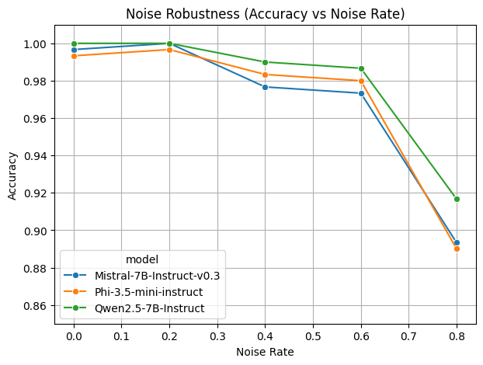
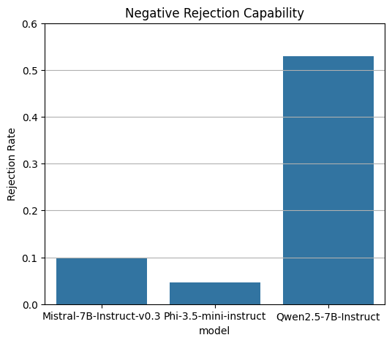
    Results
Mistral strongest
Qwen close behind
Phi drops faster with noise
Qwen best at rejecting
Mistral / Phi most prone to hallucination

Slide 4
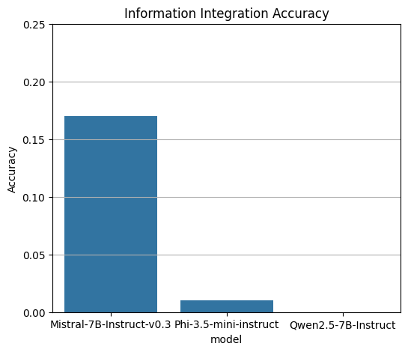
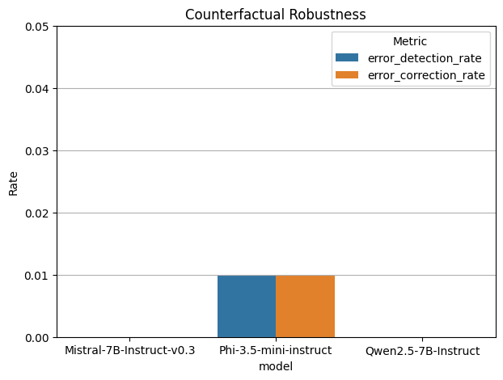
    Results
All models struggle
Mistral performs best
All models score 0.0 ~0.01
No contradiction detection

Slide 5
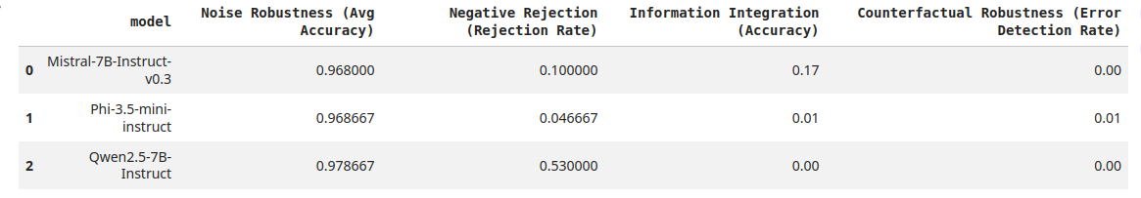
    Key Takeaways
This demonstrates that modern open-source LLMs exhibit strong robustness to noisy and incomplete information in RAG settings, particularly Mistral-7B and Qwen-2.5-7B.
However, all evaluated models fail to achieve counterfactual robustness, highlighting a significant unresolved challenge.
Addressing factual inconsistency detection and correction is essential for deploying reliable and trustworthy RAG systems in real-world applications.

Slide 6
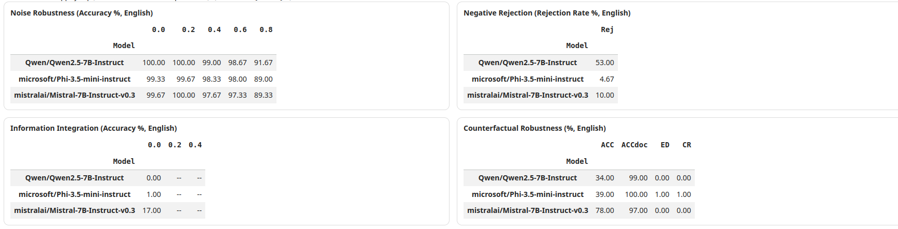
Analysis and Discussion
Noise Robustness
Mistral-7B demonstrates the strongest robustness to noisy contexts, maintaining high accuracy even when up to 80% of the documents are irrelevant.
Qwen-2.5-7B also performs well but shows slightly greater degradation.
Phi-3.5-Mini is more sensitive to noise, likely due to its smaller parameter count.
Negative Rejection
Qwen-2.5-7B achieves the highest rejection rate, indicating strong safety alignment and a conservative answering strategy.
Mistral-7B rejects inconsistently.
Phi-3.5-Mini frequently attempts to answer even when information is insufficient, increasing hallucination risk.
Information Integration
Mistral-7B outperforms other models in integrating information across multiple documents.
However, absolute accuracy remains low across all models,
suggesting that multi-document reasoning is still a challenging problem for current LLMs.
Counterfactual Robustness
All evaluated models score zero on both error detection and error correction.
This indicates a fundamental limitation:
instruction-tuned LLMs do not reliably recognize or resolve contradictions unless explicitly prompted or supported by additional verification mechanisms.

